Slide 1
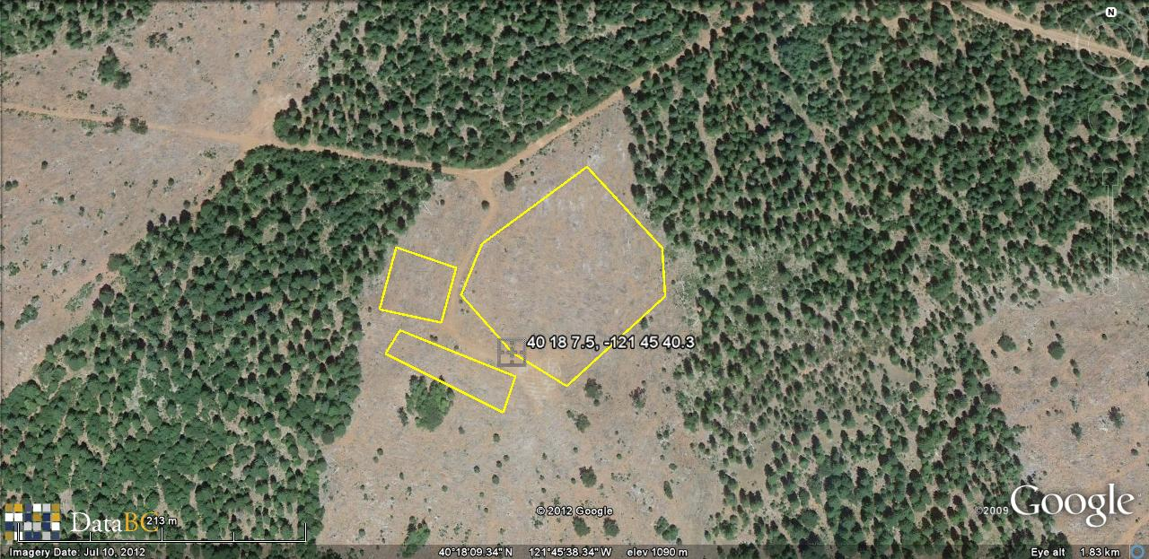
Lyman Springs AMAT Planted 2011
D
O
L
C
E
N
B
F
K
M
Rep 1
J
A
H
G
I
Rep 1
Lyman Springs
Corner geographic coordinates
A: 40°18’07.5” N
121°45’40.3” W
B: 40°18’08.9” N
121°45’42.0” W
C: 40°18’10.2” N
121°45’41.4” W
D: 40°18’12.3” N
121°45’38.2” W
E: 40°18’10.2” N
121°45’35.5” W
F: 40°18’09.0” N
121°45’35.4” W
G: 40°18’06.7” N
121°45’38.5” W
H: 40°18’06.9” N
121°45’40.1” W
I: 40°18’06.0” N
121°45’40.5” W
J: 40°18’07.4” N
121°45’44.3” W
K: 40°18’08.0” N
121°45’43.9” W
L: 40°18’09.6” N
121°45’42.2” W
M: 40°18’08.2” N
121°45’42.6” W
N: 40°18’08.5” N
121°45’44.6” W
O: 40°18’10.0” N
121°45’44.2” W
UTM Zone 10: 605324 E,
4462065 N
Contact: Dennis Garrison
Elev 1090 m

Slide 2
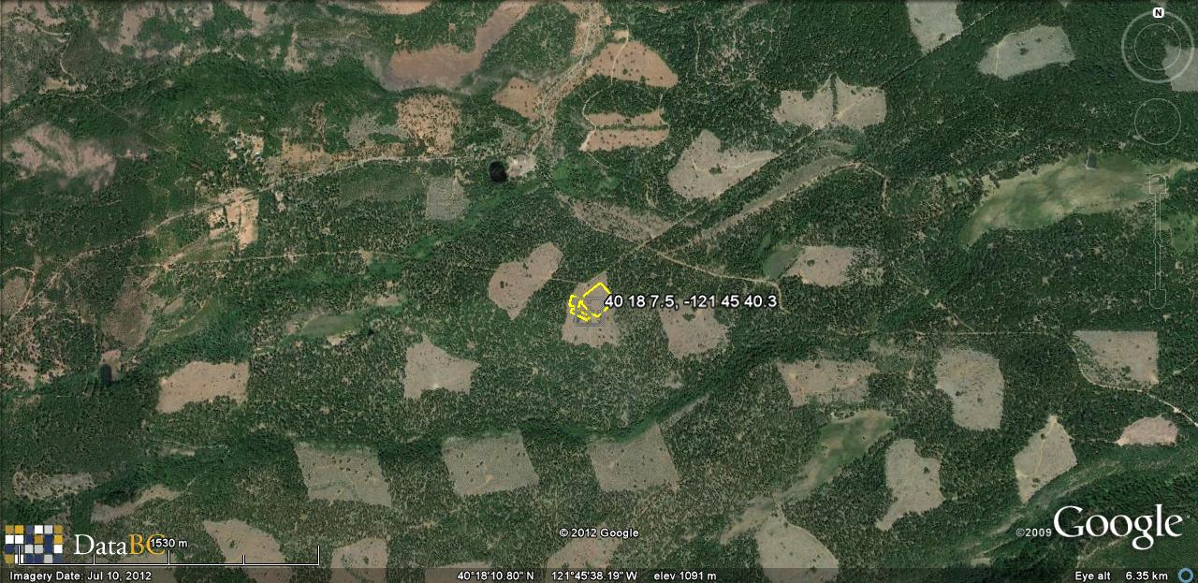
Lyman Springs 1:15,000

